Slide 1

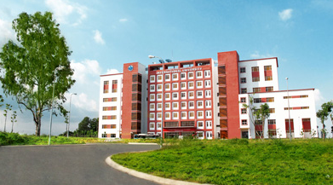
International University
MICRO-PROCESSING SYSTEM
Lecture 5:
AVR Interrupt Programming in Assembly and C
Vo Minh Thanh, M.Eng
School Of Electrical Engineering

Slide 2
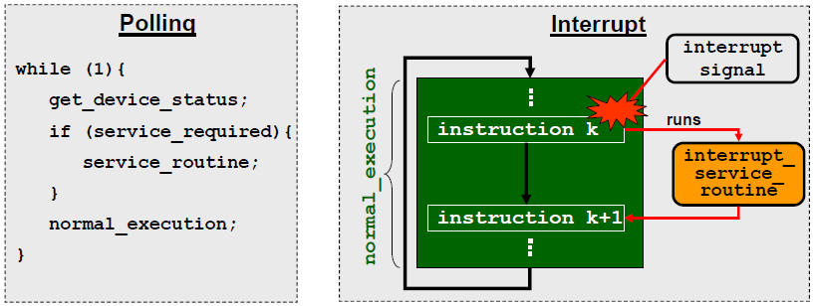
Polling versus Interrupt
Using polling, the CPU must continually check the device’s status.
Using interrupt:
A device will send an interrupt signal when needed.
In response, the CPU will perform an interrupt service routine, and then resume its normal execution.

Slide 3
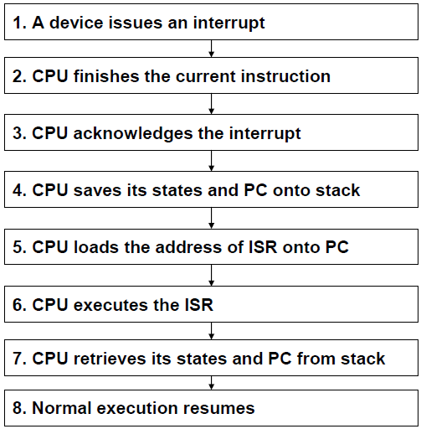
Interrupt execution sequence

Slide 4
ATmega16 interrupt subsystem
The ATmega16 has 21 interrupts:
1 reset interrupt
3 external interrupts
8 timer interrupts
3 serial port interrupts
1 ADC interrupt
1 analogue comparator interrupt
1 SPI interrupt
1 TWI interrupt
2 memory interrupts

Slide 5
Table 10-1: Interrupt Vector Table for the ATmega32 AVR
Interrupt | ROM Location (Hex)
Reset | 0000
External Interrupt request 0 | 0002
External Interrupt request 1 | 0004
External Interrupt request 2 | 0006
Time/Counter2 Compare Match | 0008
Time/Counter2 Overflow | 000A
Time/Counter 1 Capture Event | 000C
Time/Counterl Compare Match A | 000E
Time/Counter 1 Compare Match B | 0010
Time/Counterl Overflow | 0012
Time/CounterO Compare Match | 0014
Time/CounterO Overflow | 0016
SPI Transfer complete | 0018
USART, Receive complete | 001A
USART, Data Register Empty | 001C
USART, Transmit Complete | 001E
ADC Conversion complete | 0020
EEPROM ready | 0022
Analog Comparator | 0024
Two-wire Serial Interface (I²C) | 0026
Store Program Memory Ready | 0028

Slide 6
Interrupt Vector Name for the ATmega32/ATmegal6 in WinAVR
Interrupt | Vector Name in WinAVR
External Interrupt request 0 | INT0_vect
External Interrupt request 1 | INT1_vect
External Interrupt request 2 | INT2_vect
Time/Counter2 Compare Match | TIMER2_COMP_vect
Time/Counter2 Overflow | TIMER2_OVF_vect
Time/Counterl Capture Event | TIMER1_CAPT_vect
Time/Counterl Compare Match A | TIMER1_COMPA_vect
Time/Counterl Compare Match B | TIMER1_COMPB_vect
Time/Counterl Overflow | TIMER1_OVF_vect
Time/Counter0 Compare Match | TIMER0_COMP_vect
Time/Counter0 Overflow | TIMER0_OVF_vect
SPI Transfer complete | SPI_STC_vect
USART, Receive complete | USARTO_RX_vect
USART, Data Register Empty | USARTO_UDRE_vect
USART, Transmit Complete | USARTO_TX_vect
ADC Conversion complete | ADC_vect
EEPROM ready | EE_RDY_vect
Analog Comparator | ANALOG_COMP_vect
Two-wire Serial Interface | TWI_vect
Store Program Memory Ready | SPM_RDY_vect

Slide 7
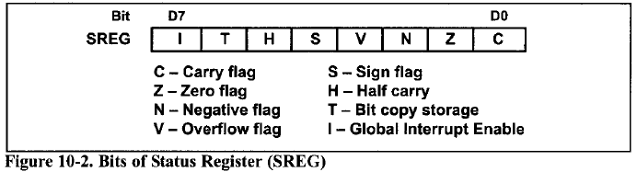
Enabling and disabling an interrupt
Upon reset, all interrupts are disabled (masked), meaning that none will be responded to by the microcontroller if they are activated.
The interrupts must be enabled (unmasked) by software in order for the uc to respond to them.
The D7 bit of the SREG (Status Register) is responsi-ble for enabling and disabling the interrupts globally.

Slide 8
Bit |  |  | D7 |  | D6 |  | D5 | D4 | D3 | D2 | D1 | D0
 |  |  | OCIE2 |  | TOIE2 |  | TICIE1 | OCIE1A | OCIE1B | TOIE1 | OCIE0 | TOIE0
 |  | TOIE0 |  | D0 |  | Timer0 Overflow Interrupt Enable: (0 / 1) = (Disable / Enable) Timer0 Overflow Interrupt
 |  | OCIE0 |  | D1 |  | Timer0 Output Compare Match Interrupt Enable: (0 / 1) = (Disable / Enable) Timer0 Compare Match Interrupt
 |  | TOIE1 |  | D2 |  | Timer1 Overflow Interrupt Enable: (0 / 1) = (Disable / Enable) Timer1 Overflow Interrupt
 |  | OCIE1B |  | D3 |  | Timer1 Output Compare B Match Interrupt Enable: (0 / 1) = (Disable / Enable) Timer1 Compare B Match Interrupt
 |  | OCIE1A |  | D4 |  | Timer1 Output Compare A Match Interrupt Enable: (0 / 1) = (Disable / Enable) Timer1 Compare A Match Interrupt
 |  | TICIE1 |  | D5 |  | Timer1 Input Capture Interrupt Enable: (0 / 1) = (Disable / Enable) Timer1 Input Capture Interrupt
 |  | TOIE2 |  | D6 |  | Timer2 Overflow Interrupt Enable: (0 / 1) = (Disable / Enable) Timer2 Overflow Interrupt
 |  | OCIE2 |  | D7 |  | Timer2 Output Compare Match Interrupt Enable: (0 / 1) = (Disable / Enable) Timer2 Compare Match Interrupt
 | These bits, along with the I bit, must be set high for an interrupt to be responded to. Upon activation of the interrupt, the I bit is cleared by the AVR itself to make sure another interrupt can not interrupt the microcontroller while it is servicing the current one. At the end of the ISR, the RETI instruction will make I = 1 to allow another interrupt to come in.
Figure 10-3: TIMSK (Timer Interrupt Mask) Register

Slide 9
Steps to program an interrupt in C
Include header file #include <avr\interrupt.h>.
Clear (disable interrupts globally) and Set (enable interrupts globally) the I bit of the SREG register using cli () and sei () macros.
Defining ISR: To write an ISR (interrupt service routine) for an interrupt we use the following structure:
ISR (interrupt_vector_name) {
//our program
}
For example, the following ISR serves the Timer0 compare match interrupt:
ISR (TIMER0_COMP_vect){
}

Slide 10
Timer0 Interrupt Programming
// Using TimerO generate a square wave on pin PORTB.5, while
// at the same time transferring data from PORTC to PORTD.
#include <avr/io.h>
#include <avr/interrupt.h>
int main(){
DDRB = 0x20; // DDRB.5 = output
TCNT0 = -32; // timer value for 4 us
TCCR0 = 0x01; // Normal mode, int elk, no prescaler
TIMSK = (1<<TOIE0); // enable Timer0 overflow interrupt
sei(); // enable interrupts globally
DDRC = 0x00; // make PORTC input
DDRD = 0xFF; // make PORTD output
while (1) // wait here
PORTD = PINC; // transfer data from PortC to PortD
}
ISR (TIMER0_OVF_vect){ // ISR for Timer0 overflow
TCNT0 = -32; // timer value for 4 us
PORTB ^= 0x20; // toggle PORTB.5
}

Slide 11
Example 10-9: timer0, timer1 Interrupt (1/2)
// Using Timer0 and Timer1 interrupts, generate square waves
// on pins PB1 and PB7 respectively, while transferring data
#include <avr/io.h> // from PORTC to PORTD
#include <avr/interrupt.h>
int main (){
DDRB |= 0x82; // make DDRB.l and DDRB.7 output
DDRC = 0x00; // make PORTC input
DDRD = 0xFF; // make PORTD output
TCNT0 = -160; // start from 96
TCCR0 = 0x01; // Normal mode,inernal clk, no prescaler
TCNT1H = (-640)>>8; // the high byte 0xFD
TCNT1L = (-640); // the low byte 0x80
TCCR1A = 0x00; // timer1 in normal mode, no prescaler
TCCR1B = 0x01; // use internal CLK.
// enable Timers 0 and 1 interrupts.
TIMSK = (1<<TOIE0) | (1<<TOIE1);
sei (); // enable global interrupts, set bit7 of SREG
while (1) // wait here
PORTD = PINC;
}

Slide 12
Example 10-9: timer0, timer1 Interrupt (2/2)
// Using Timer0 and Timerl interrupts, generate square waves
// on pins PB1 and PB7 respectively, while transferring data
ISR (TIMER0_OVF_vect){ //ISR for Timer0 overflow
TCNT0 = -160; // TCNT0 = -160 (reload for next round)
PORTB ^= 0x02; // toggle PORTB.1
}
ISR (TIMER1_OVF_vect){ // ISR for Timer1 overflow
TCNT1H = (-640)>>8;
TCNT1L = (-640); // TCNT1 = -640 (reload for next round)
PORTB ^= 0x80; // toggle PORTB.7
}

Slide 13
Timer0 Output Compare Match Interrupt
#include "avr/io.h"
#include "avr/interrupt.h"
int main ()
{
DDRB |= 0x20; // make DDRB.5 output
OCR0 = 40;
TCCR0 = 0x09; // CTC mode, internal elk, no prescaler
TIMSK = (1<<OCIE0); //enable TimerO compare match int.
sei(); // enable interrupts
DDRC = 0x00; // make PORTC input
DDRD = 0xFF; // make PORTD output
while (1) // wait here
PORTD = PINC;
}
ISR (TIMER0_COMP_vect){ // ISR for TimerO compare match
PORTB ^= 0x20; //toggle PORTB.5
}

Slide 14
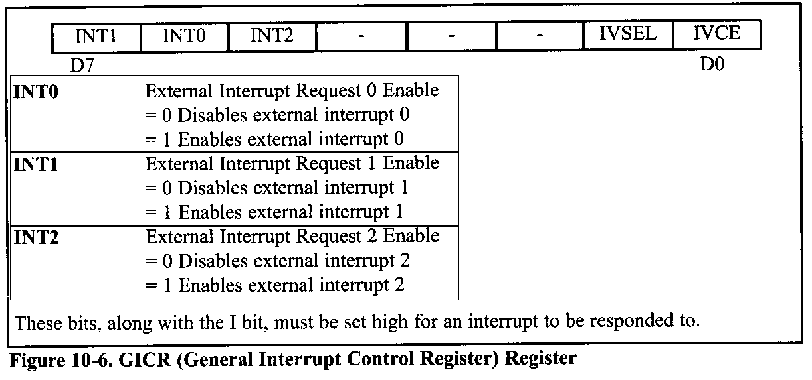
External Hardware Interrupts
The ATmega32 has three external hardware interrupts: pins PD2 (PORTD.2), PD3 (PORTD.3), and PB2 (PORTB.2), designated as INT0, INT1, and INT2, respectively.
Upon activation of these pins, the AVR is interrupted in whatever it is doing and jumps to the vector table to perform the interrupt service routine.

Slide 15
External Hardware Interrupts
The interrupt vector table locations $2, $4, and $6 are set aside for INT0, INT1, and INT2, respectively.
The hardware interrupts must be enabled before they can take effect. This is done using the INTx bit located in the GICR register.
Upon reset INT0 and INT1 are low-level-triggered interrupts.
INT2 is only edge triggered, while INT0 and INT1 can be level or edge triggered.
The bits of the MCUCR register indicate the trigger options of INT0 and INTl, as shown in Figure 10-7.
Interrupts pulses shorter than 1 machine cycle are not guaranteed to generate an interrupt.
when an interrupt is in level-triggered mode, the pin must be held low for a minimum time of 5 machine cycles to be recognized.

Slide 16
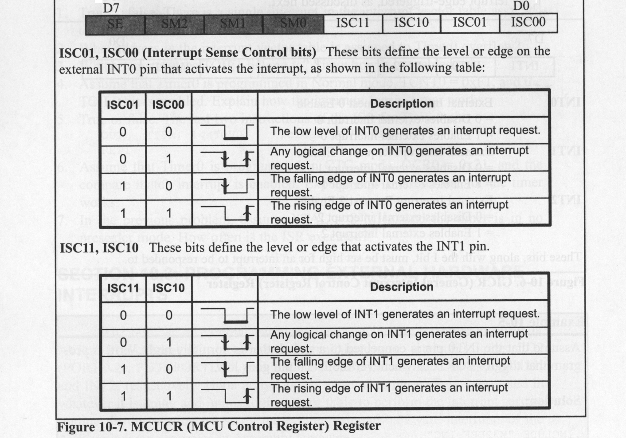

Slide 17
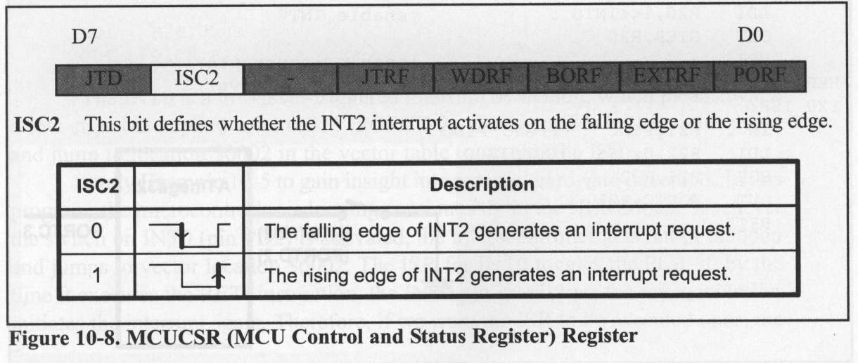
External Hardware Interrupts
The ISC2 bit of the MCUCSR register defines whether INT2 activates in the falling edge or the rising edge (Figure 10-8).
Upon reset ISC2 is 0, meaning that the external hardware interrupt of INT2 is falling edge triggered.

Slide 18
Using level-triggered Interrupt INT0
// Assume that the INT0 pin is connected to a switch that is
// normally high. Write a program that toggles PORTA.0,
// whenever INTO pin goes low. Use the external interrupt in
// level-triggered mode.
#include "avr/io.h"
#include "avr/interrupt.h"
int main (){
DDRA = (1<<0); // PA0 as an output
PORTD = (1<<2); // pull-up activated
MCUCR = 0x00; // make INT0 low level triggered
// MCUCR = 0x02; // make INT0 falling edge triggered
GICR = (1<<INT0) ; // enable external interrupt 0
sei (); // enable interrupts
while (1); // wait here
}
ISR (INT0_vect){ // ISR for external interrupt 0
PORTA ^= (1<<0) ; // toggle PORTA.0
}

Slide 19
Using edge-triggered Interrupt INT0
// Assume that the INT0 pin is connected to a switch that is
// normally high. Write a program that toggles PORTA.0 only
// once whenever INTO pin goes low. (Use the external
// interrupt in edge-triggered mode).
#include "avr/io.h"
#include "avr/interrupt.h"
int main (){
DDRC = 1<<3; // PC3 as an output
PORTD = 1<<2; // pull-up activated
MCUCR = 0x02; // make INT0 falling edge triggered
GICR = (1<<INT0) ; // enable external interrupt 0
sei (); // enable interrupts
while (1); //wait here
}
ISR (INT0_vect){ // ISR for external interrupt 0
PORTC ^= (1<<3) ; // toggle PORTC.3
}

Slide 20
Using INT0, INT1 and INT2
#include "avr/io.h"
#include "avr/interrupt.h"
int main (){
DDRA = 0xFF; // PA as an output
MCUCR = 0x00; // make INT0 and INT1 low level triggered
MCUCSR = (1<<ISC2); // make INT2 rising edge triggered
GICR = (1<<INT0)|(1<<INT1)|(1<<INT2);
sei (); // enable interrupts
while (1); // wait here
}
ISR (INT0_vect){ // ISR for external interrupt 0
PORTA ^= (1<<0) ; // toggle PORTA.0
}
ISR (INT1_vect){ // ISR for external interrupt 1
PORTA ^= (1<<1) ; // toggle PORTA.1
}
ISR (INT2_vect){ // ISR for external interrupt 2
PORTA ^= (1<<2) ; // toggle PORTA.2
}

Slide 21
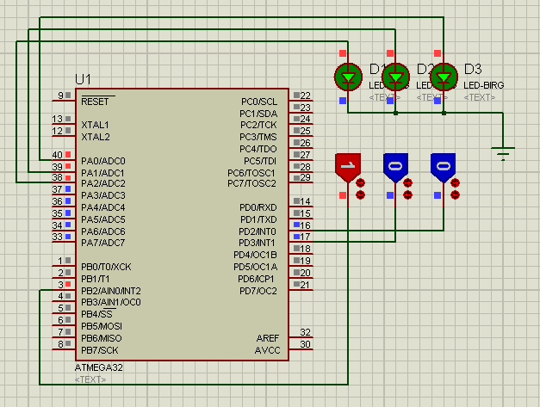
Using INT0, INT1 and INT2

Slide 22
Interrupts Priority
If two interrupts are activated at the same time, the interrupt with the higher priority is served first.
The priority of each interrupt is related to the address of that interrupt in the interrupt vector.
The interrupt that has a lower address, has a higher priority. See Table 10-1.
For example, the address of external interrupt 0 is 2, while the address of external interrupt 2 is 6; thus, external interrupt 0 has a higher priority, and if both of these interrupts are activated at the same time, external interrupt 0 is served first.

Slide 23
Interrupt latency
The time from the moment an interrupt is activated to the moment the CPU starts to execute the task is called the interrupt latency. This latency is 4 machine cycle times.
During this time the PC register is pushed on the stack and the I bit of the SREG register clears, causing all the interrupts to be disabled.
The duration of an interrupt latency can be affected by the type of instruction that the CPU is executing when the interrupt comes in,
since the CPU finishes the execution of the current instruction before it serves the interrupt. It takes slightly longer in cases where the instruction being executed lasts for two (or more) machine cycles (e.g., MUL) compared to the instructions that last for only one instruction cycle (e.g., ADD).

